Slide 1
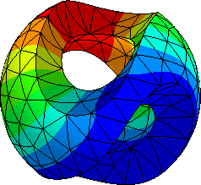

Bi-directional Weak Coupling of Integral Element Method and NGSolve for Magnetic Levitation Analysis
June 30, 2026
Takaaki Yano，Kengo Sugahara (Kindai University)
Notes:
Good morning everyone. My name is Takaaki Yano from Kindai University. Thank you for giving me this opportunity to present. This work is co-authored with Professor Kengo Sugahara.

Slide 2
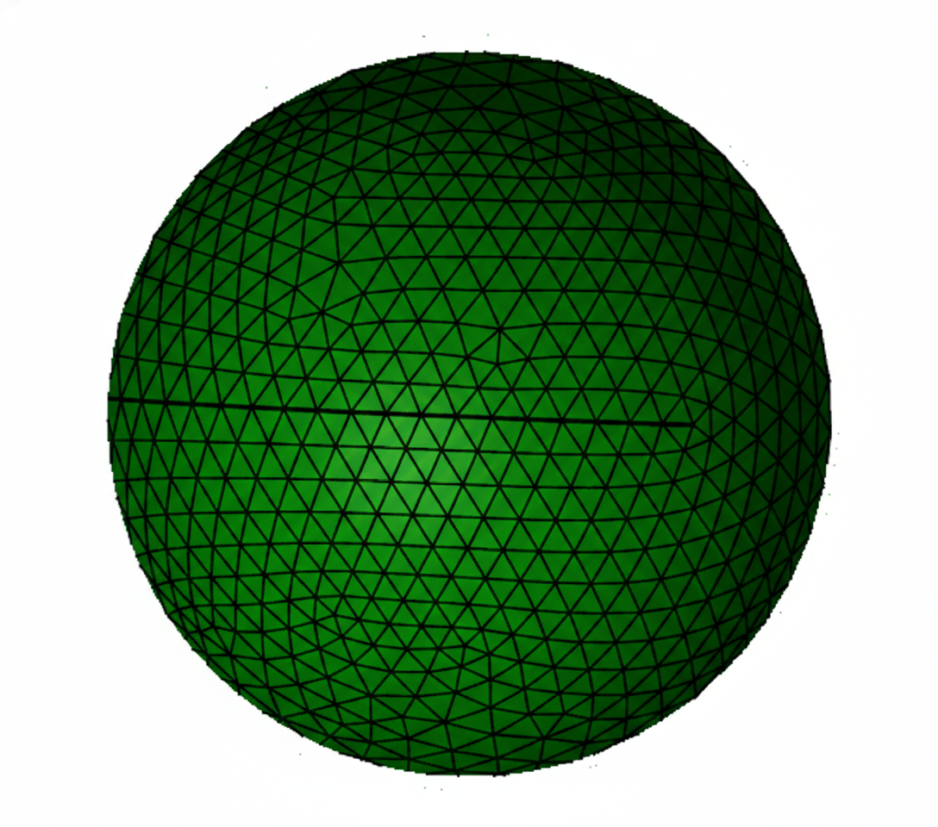
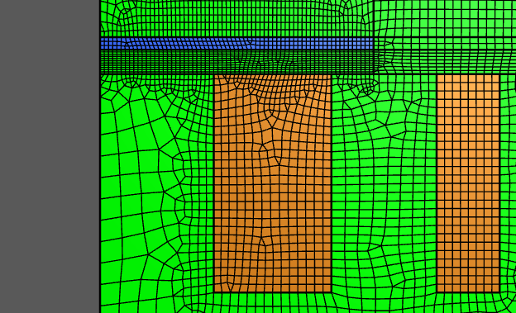
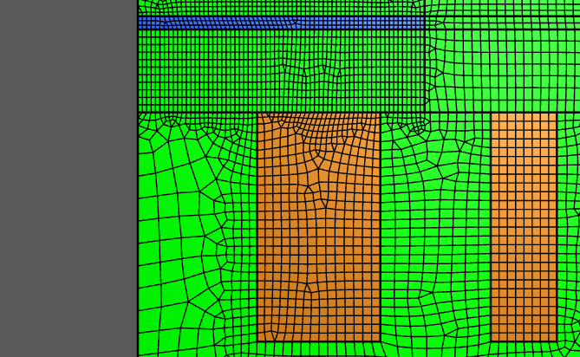
Conductive plate
Handling Moving Bodies in NGSolve
l
Air domain
d
Moving object
Coil
Target model
Stretch
Contraction
l
Expansion
d
Finite Element Method（FEM）
✓ Superior performance in eddy current analysis
✓ Flexible handling of non-linear materials
✗ Discretization of air region required
✗ Remeshing required at each movement step
Analysis example:TEAM28
1
Notes:
Let me begin with the motivation. As NGSolve users know well, NGSolve is very strong for eddy-current analysis and can treat nonlinear materials with high accuracy. Benchmark problems such as TEAM 28 have been solved with FEM precisely because of these strengths. However, when moving bodies are involved, the air-region mesh has to be regenerated or deformed every time the body moves. For large or complex models, this remeshing process can become a dominant computational cost. It can also introduce mapping errors. Because the mesh topology changes between time steps, conservation properties are not always preserved exactly. To address this moving-body difficulty, we propose combining NGSolve with the Integral Element Method, or IEM. In this talk, I will introduce this coupling framework and an MCP server that makes it usable from natural language prompts.

Slide 3
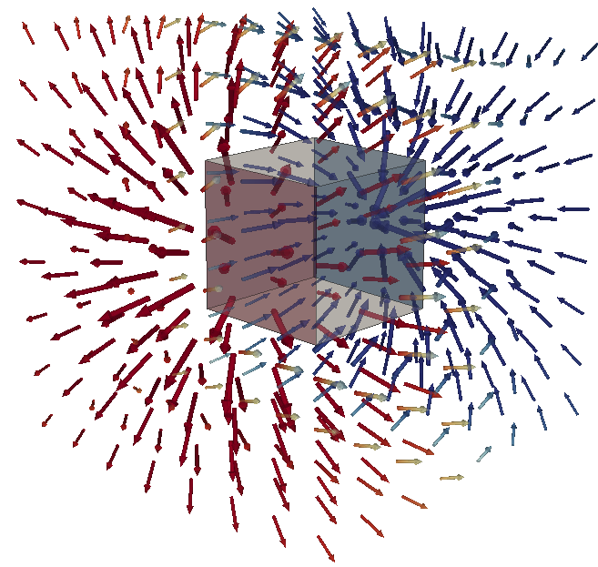
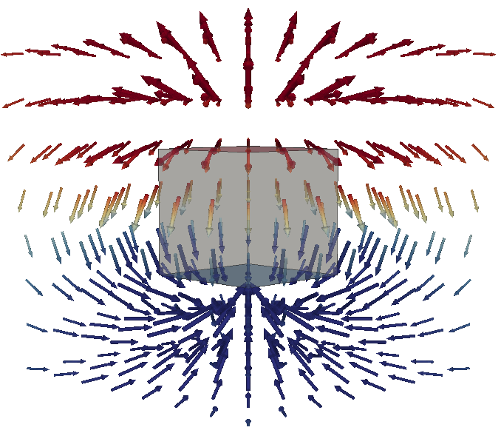
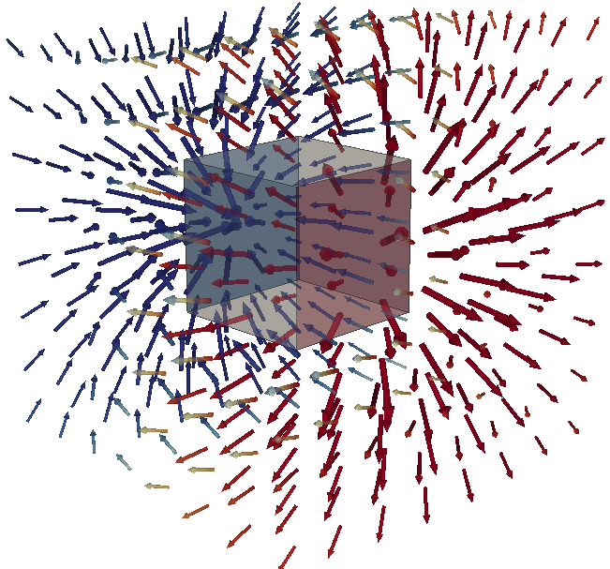
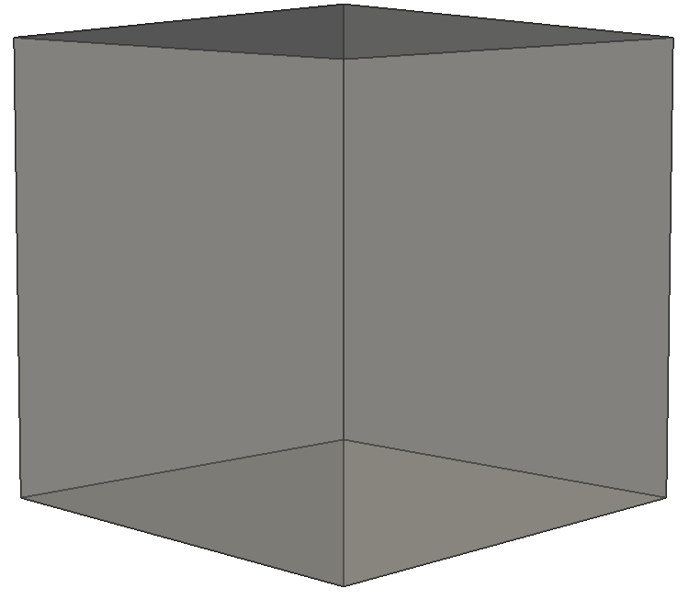
Conventional Magnetic Moment Method (MMM)
Hexahedron (3DoF)
Dipole
X-coordinate
Dipole
Z-coordinate
Dipole
Y-coordinate
Magnetic Moment Method (MMM)
✓ Air region mesh not required
✓ Motion support via coordinate transformation only
✓ Fewer and coarser elements than FEM
✓ Nonlinear materials
2
Notes:
The specific IEM technique used here is the Magnetic Moment Method, or MMM. MMM divides the magnetic body into elements, represents each element by a magnetic moment, and solves the magnetic-field interactions between elements as a system of equations. No air-region mesh is required, and moving bodies can be handled by coordinate transformation only. The major practical advantage of MMM is that magnetization can be replaced by equivalent surface magnetic charges, so element interactions can be evaluated analytically. The boundary condition on each face is then imposed at one face-center collocation point. This combination of analytical kernels and collocation makes the matrix build extremely lightweight. Because of this light structure, MMM is convenient for iterative moving-body calculations and for nonlinear magnetic materials, while avoiding repeated remeshing of the air region. This is why MMM is attractive for the coupling framework. On the other hand, in conventional MMM, each element has a fixed 3 degrees of freedom, regardless of its shape. Each element is represented by a uniform magnetization vector M, with components M x, M y, and M z. In terms of multipole modes, the three uniform magnetization components correspond to dipole X, dipole Y, and dipole Z. Conventional MMM therefore represents only these three dipole components. In other words, it approximates the magnetization inside one element by a single constant vector. The next slide shows how far this approximation can go when the elements are very coarse.

Slide 4
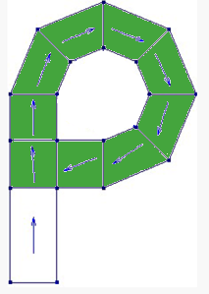
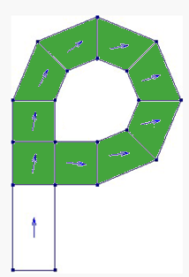
Conventional Magnetic Moment Method (MMM)
Hexahedron (3DoF)
Dipole
X-coordinate
Dipole
Z-coordinate
Dipole
Y-coordinate
Magnetic Moment Method (MMM)
✓ Air region mesh not required
✓ Motion support via coordinate transformation only
✓ Fewer and coarser elements than FEM
✓ Nonlinear materials
magnetic material
magnet
3DoF
6DoF
2
Notes:
Please look at the two figures in the lower-right corner. Green denotes magnetic material, blue denotes the magnet, and the white hole is a non-magnetic region. The left figure is the 3 degree-of-freedom case, and the right figure is the 6 degree-of-freedom case. This is an example of a P-shaped magnet represented with an extremely small number of elements. In the left 3 degree-of-freedom MMM case, the magnetization inside one element is represented by a single constant vector. When the magnetic flux bends inside the element, when transverse leakage components appear, or when the element shape is distorted, a coarse mesh tends to leave noticeable error. To obtain high accuracy with conventional MMM, the mesh often has to be aligned with the flux direction, or the body has to be divided into many small elements. In the right 6 degree-of-freedom MMMM case, the idea is not just to add unknowns. The six degrees of freedom are organized as physical multipole modes: dipoles and quadrupoles. The dipole modes represent bulk magnetization, while the quadrupole modes represent field gradients and non-uniform distributions inside the element. By matching the degrees of freedom to these physical modes, coarse or moderately distorted elements can represent flux bending and transverse variation more naturally. In this P-shaped magnet example, the purpose is to suppress non-physical behavior and move closer to practical accuracy even with extremely few elements. This is the main motivation for extending 3 degree-of-freedom MMM to 6 degree-of-freedom MMMM.

Slide 5
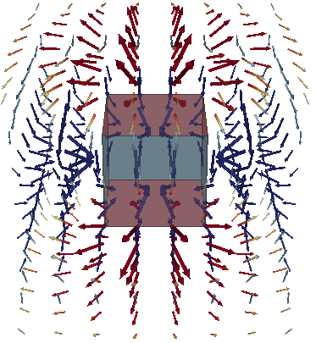
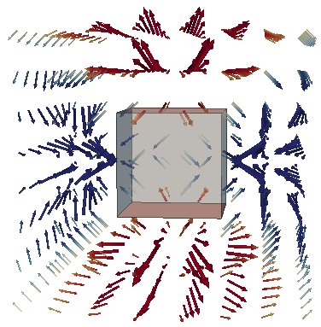
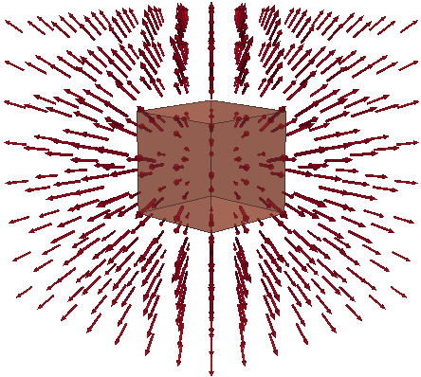
Multipole Magnetic Moment Method (MMMM)
Dipole
X-coordinate
Dipole
Z-coordinate
Dipole
Y-coordinate
Hexahedron (6DoF)
✓ Practical accuracy with fewer elements ✓ Robust to coarse / distorted meshes
✗ no eddy currents
Monopole
Quadrupole 1
Quadrupole2
2
Notes:
Based on this motivation, I will explain the essence of the Multipole Magnetic Moment Method, or MMMM, using only the hexahedral case. MMMM does not use the face magnetic charges directly as arbitrary degrees of freedom. Instead, it closes the system using moment conditions, such as charge neutrality, centroid field, and centroid field-gradient conditions, and decomposes the unknowns into physically meaningful multipole modes. The monopole is always zero because of magnetic-charge conservation. Dipole X, dipole Y, and dipole Z correspond to the bulk magnetization components. Quadrupole 1 and quadrupole 2 are shape-correction modes that represent field gradients and non-uniform distributions. This gives 6 degrees of freedom per hexahedral element. The slide also shows the monopole mode shape, but its coefficient is constrained to zero by magnetic-charge conservation. The point I want to emphasize here is that the 6 degrees of freedom introduced on the previous slide are not arbitrary face unknowns. They are defined as low-order multipole modes. The collocation framework is kept, but the surface-charge degrees of freedom are matched to three dipole modes and two quadrupole modes. This allows the intra-element variation that was forced into one constant vector in 3 degree-of-freedom MMM to be represented by a small number of additional modes. The green items on the slide summarize this effect. The method can approach practical accuracy with fewer elements, and it is more robust to coarse or distorted meshes. However, the red item on the slide is important: MMM and MMMM alone do not solve eddy currents. The external field of magnets and magnetic materials is handled by Radia and MMMM, while the eddy currents and reaction field in conductors are handled by NGSolve.

Slide 6
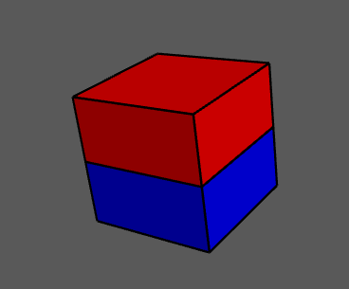
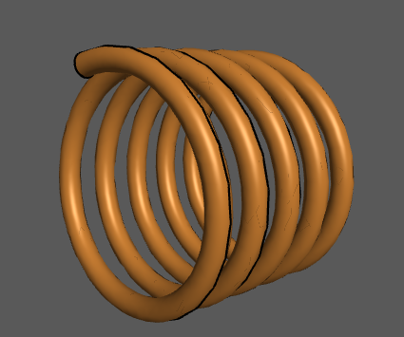
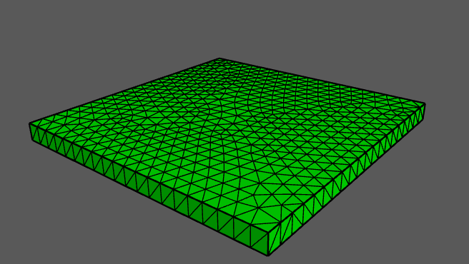
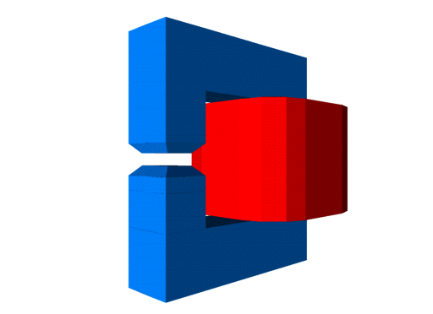
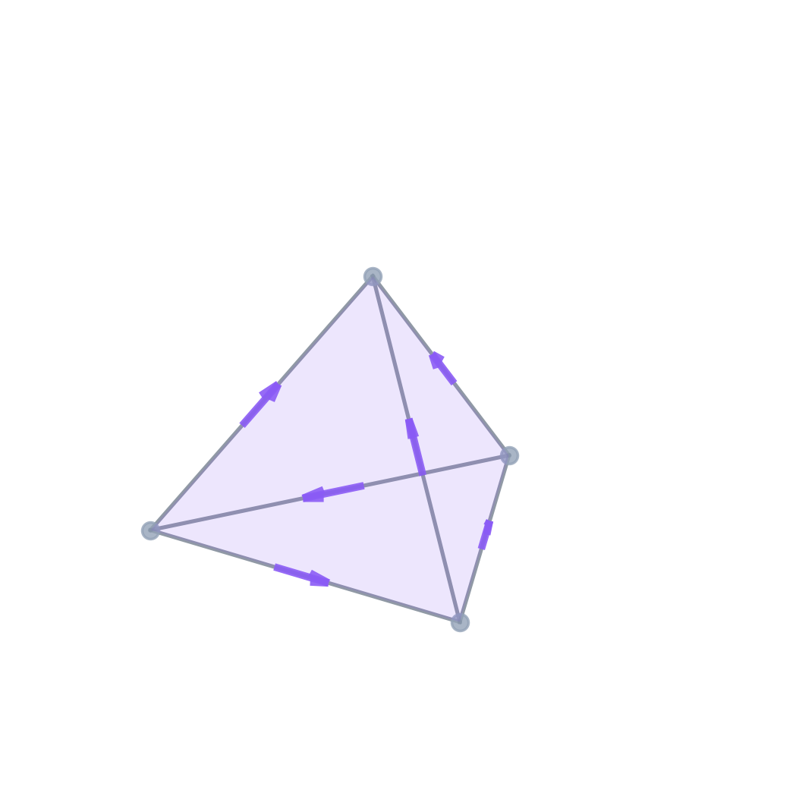
Radia-NGSolve
Radia (Original)
Radia (Fork)
NGSolve
N
MMM
Developed at ESRF
S
Written in C++
Radia (Fork)
Unified Python API framework
Light-Weight Field Solvers
MMMM
Forked at Kindai
Couple
Pybind11
Radia (Fork)
NGSolve
Pybind11
Grid Function
4
Notes:
Now I will explain how this division of roles is connected in software. At Kindai University, we are developing a coupling framework called Radia-NGSolve. As introduced in the previous talk, Radia is an MMM solver originally developed at ESRF. We forked it at Kindai University and extended it. The extensions relevant to this presentation are MMMM implementation, lightweight analytical field calculations for magnets and coils, and a Pybind11-based Python API for coupling with NGSolve. Most importantly, Radia is placed on the same Pybind11-based Python API framework as NGSolve. This means Radia and NGSolve can be coupled seamlessly in a single Python script using the coding style familiar to NGSolve users.

Slide 7
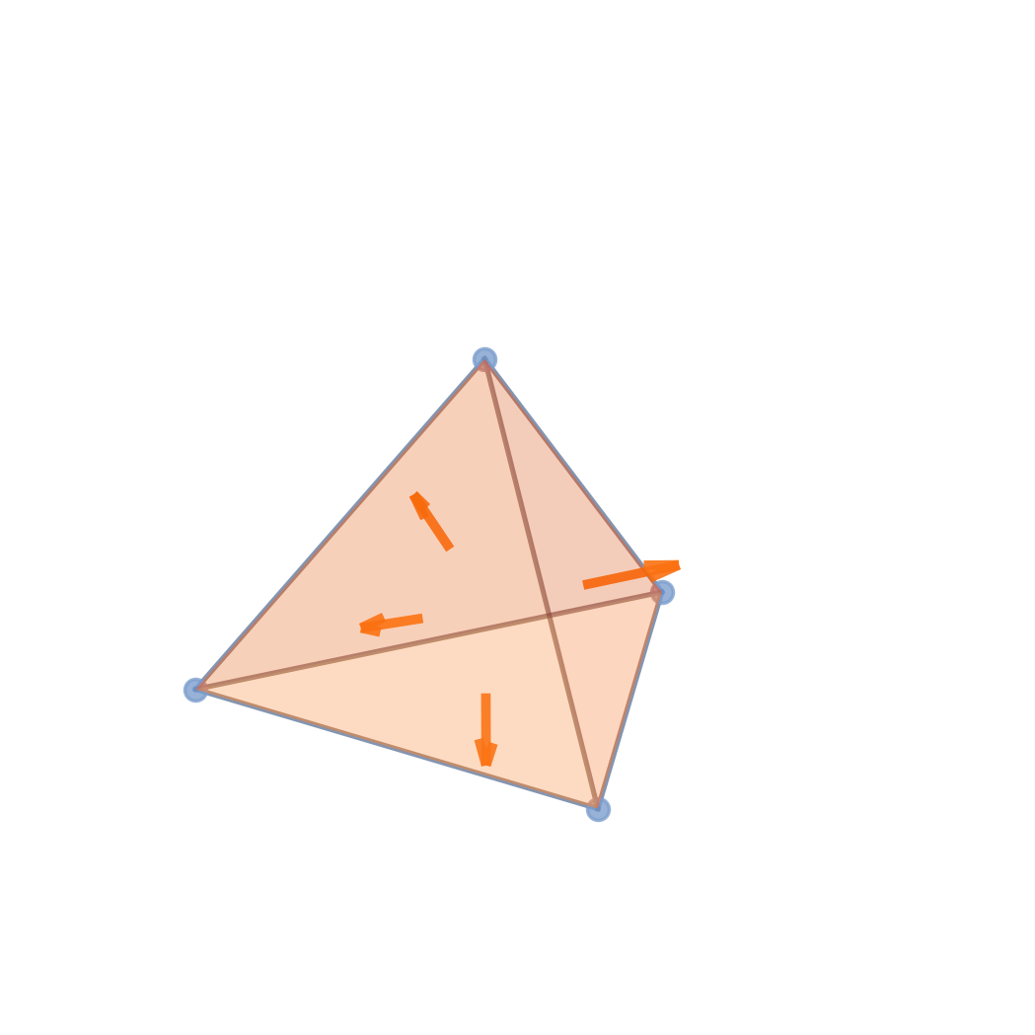
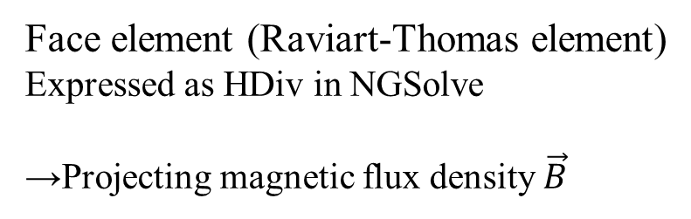
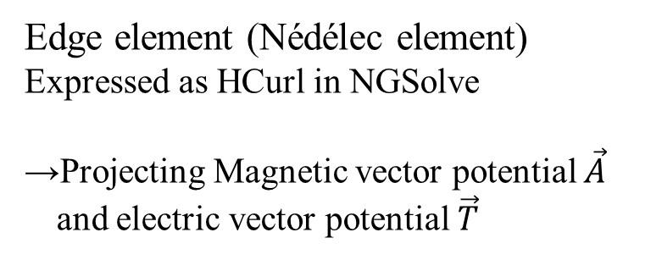

Coefficient Function and Grid Function
GridFunction
NGSolve
Radia (Fork)
Results in Finite Element Space
CoefficientFunction
Edge element (Nédélec element)
Expressed as HCurl in NGSolve
→Projecting Magnetic vector potential $\vec{A}$
and electric vector potential $\vec{T}$
Formula before evaluation based on coordinates
example
$$\vec{B}\left(\vec{r}\right)=\frac{μ_{0}}{4π}\int_{V}{\frac{\vec{J}(\vec{r^{′}})×(\vec{r}−\vec{r^{′}})}{{\left|\vec{r}−\vec{r^{′}}\right|}^{3}}dl}$$
Face element (Raviart-Thomas element)
Expressed as HDiv in NGSolve
→Projecting magnetic flux density $\vec{B}$
Projecting entered values onto finite element space
5
Notes:
As a concrete example of the unified API, let me show how Radia passes a field to NGSolve. Because Radia shares the same Pybind11-based Python API framework as NGSolve, the external magnetic field computed by Radia can be passed directly to NGSolve as a CoefficientFunction. There is no intermediate file format and no memory-copy overhead. This is particularly important for moving-body problems. Since the Radia object behaves as an NGSolve CoefficientFunction, NGSolve can use its own coordinate-transformation mechanism, namely ElementTransformation, to evaluate the moved and rotated Radia field at each integration point. There is no need to precompute a field map, interpolate it, or copy it onto a mesh. The Radia-based CoefficientFunction can then be projected onto the appropriate conforming finite element space: H-Curl for the magnetic vector potential A and electric vector potential T, or H-Div for the magnetic flux density B. The result is a GridFunction that can be used directly as a FEM source term. The basic flow is that Radia exposes the external field as a CoefficientFunction. NGSolve projects it to a GridFunction in an H-Curl or H-Div space. That GridFunction is used as a FEM source term for the reaction field, including eddy currents. At the C++ level, this is realized through NGSolve's ElementTransformation, often called trafo. At each integration point, Radia's analytical IEM calculation is called directly, without copying a precomputed field map onto the mesh.

Slide 8


Operation of the MCP Server in This Presentation
Radia-NGSolve MCP Server
Skills
Lint
API specifications Usage examples Best practices
Natural Language
Prompt
Requirement
Automated code syntax and style checker
LLM Agent
Claude Code
Python API
User
Codebase
Knowledge
+ Quality check
Radia
NGSolve
6
Notes:
The remaining issue is usability. Implementing the reduced potential method or Kelvin transformation correctly requires detailed knowledge of the NGSolve API. This is where the MCP server comes in. MCP stands for Model Context Protocol. It is an open protocol that allows large language models to interact with custom knowledge bases and tools. Our MCP server contains API specifications, usage examples, best practices, skills for complex procedures such as Kelvin transformation, and references to the codebase. When a user enters a natural language prompt, an LLM agent refers to this information and generates Python code. The generated code is then checked by a lint system. The lint detects NGSolve-specific mistakes such as mismatches between finite element spaces and CoefficientFunction dimensions, or incorrect use of definedon for boundary conditions. The goal is to obtain correct analysis code from natural language without reading the API documentation manually.

Slide 9
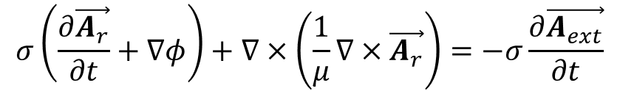

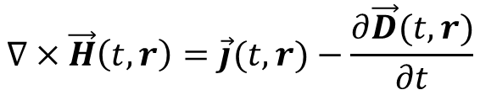



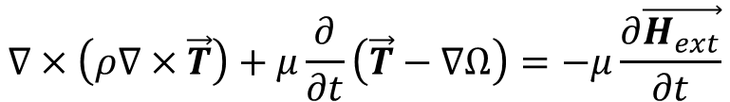


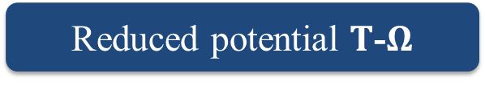


MCP Knowledge Base - Example 1: Reduced potential
Reduced potential $A$-$φ$
$$σ\left(\frac{∂\vec{A_{r}}}{∂t}+∇φ\right)+∇×\left(\frac{1}{μ}∇×\vec{A_{r}}\right)=−σ\frac{∂\vec{A_{ext}}}{∂t}$$
Maxwell’s equations
FEM
MMM
$$∇∙\vec{B} =0$$
$\vec{A}$ : Magnetic vector potential
$$∇×\vec{E}=−\frac{∂\vec{B} }{∂t}$$
$φ$ ： Electric scalar potential
Formula transformation
$$∇∙\vec{D}\left(t, r\right)=ρ(t,r)$$
Reduced potential $T$-$Ω$
$$∇×\vec{H}\left(t, r\right)=\vec{j}(t,r)−\frac{∂\vec{D}(t,r)}{∂t}$$
$$∇×\left(ρ∇×\vec{T}\right)+μ\frac{∂}{∂t}\left(\vec{T}−∇Ω\right)=−μ\frac{∂\vec{H_{ext}}}{∂t}$$
FEM
MMM
$\vec{T}$ ： Electric vector potential
$Ω$ ： Magnetic scalar potential
7
Notes:
As one example of knowledge stored in the MCP server, let me introduce the reduced potential method. The reduced potential method decomposes the total magnetic field into an external field, computed by IEM and Radia, and a reaction field, computed by FEM and NGSolve. The framework supports multiple formulations. Here I show two representative ones: the A-phi formulation and the T-Omega formulation. In the slide, the orange terms represent source terms provided by IEM and Radia, and the blue terms represent reaction-field terms computed by FEM and NGSolve. NGSolve solves these formulations to compute the conductor-side reaction field to the external field. This formulation knowledge is stored in the MCP server, so users can obtain either A-phi or T-Omega implementation code from a single prompt.

Slide 10
MCP Knowledge Base - Example 2: Kelvin transformation
Kelvin-transformed air region
Infinite to Finite: Projects the external infinite domain onto a finite inversion sphere.
Unknown equivalent
(Identical mesh)
Boundary Integration: Couples internal and external boundaries via an equivalent boundary.
Target model
[1] J.-F. Imhoff, G. Meunier, X. Brunotte, J. C. Sabonnadière, "An original solution for unbounded electromagnetic 2D- and 3D-problems throughout the finite element method," *IEEE Trans. Magn.*, vol. 26, no. 5, pp. 1659–1661, 1990.
[2] K. Sugahara, "Electromagnetic Analysis of Eddy Current Testing With Kelvin Transformation," *IEEE Trans. Magn.*, vol. 58, no. 9, Sep. 2022, doi: 10.1109/TMAG.2022.3194371.
8
Notes:
The MCP server also provides skills, which are registered procedures for complex multi-step operations. A concrete example is the Kelvin transformation. FEM can only handle finite meshes, so open-boundary problems require a truncation boundary, which introduces error. The Kelvin transformation maps the infinite exterior domain onto a finite inversion sphere. This allows open-boundary conditions to be represented inside a finite mesh. The difficult point is that the surface mesh on the interface must be identical on the inner and outer sides. This requires internal Netgen and NGSolve operations such as mesh copying and periodic identification, so it is not easy to write by hand. By registering this entire procedure as a skill, the LLM can generate correct implementation code from a natural language prompt such as, apply the Kelvin transformation. The generated code is also checked by lint, so mistakes in boundary identification can be detected before execution.

Slide 11
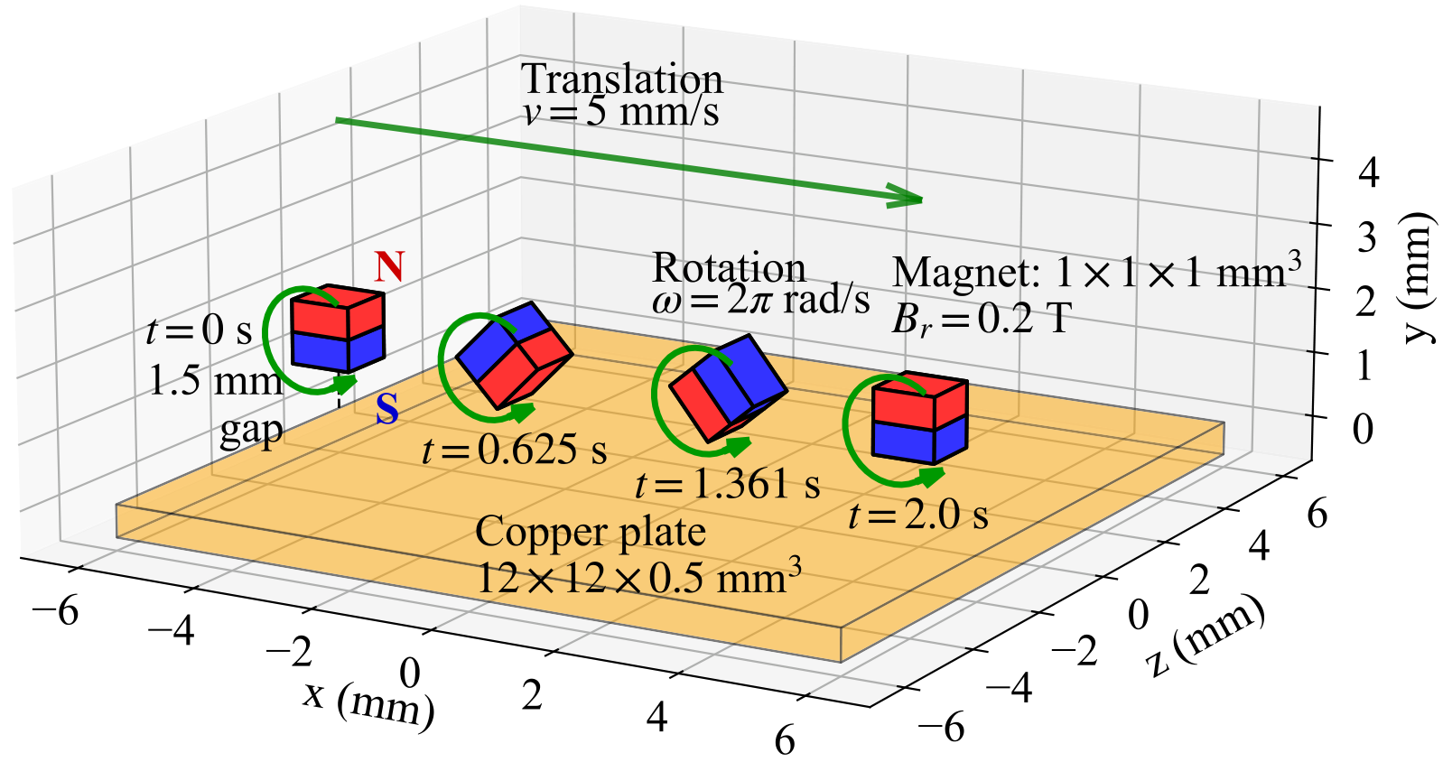
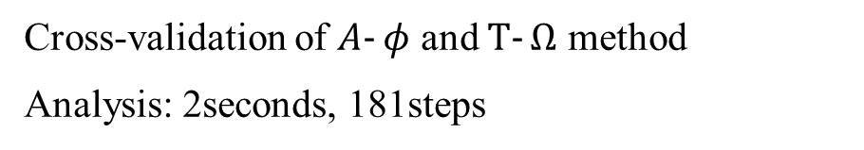
Example: Rotating and Translating magnet
Cross-validation of $A‐φ$ and $T‐Ω$ method
Analysis: 2seconds, 181steps
Items | Parameter | Value
PM | Remanence | 0.2 T
 | Dimensions | 1×1×1 mm³
Copper plate | Dimensions | 12×12×0.5 mm³
 | Conductivity σ | 5.8×10⁷ S/m
PM motion | Translation | X: -6→4 mm
 | Rotation | 720° about Z-axis
Target model
Example of natural language prompt:
A 1mm cubic permanent magnet (Br=0.2T) translates along X (-6mm→4mm) while rotating about the Z-axis (4°/step)
Copper plate (12mm×0.5mm×12mm, σ=5.8×10⁷ S/m) placed at Y=[-0.5, 0]mm
9
Notes:
Let me now demonstrate the framework with a numerical example. The model is a rotating and translating permanent magnet over a copper plate. The permanent magnet has a remanence of 0.2 tesla and dimensions of 1 by 1 by 1 millimeter. The copper plate is 12 by 12 by 0.5 millimeters, with conductivity 5.8 times 10 to the 7 siemens per meter. The magnet translates in the X direction from negative 6 millimeters to positive 4 millimeters, and rotates about the Z axis by 4 degrees per step, for a total rotation of 720 degrees. The analysis consists of 181 time steps over 2 seconds. The slide also shows an example natural language prompt entered into the MCP server. From this prompt, the LLM automatically generates the analysis code. The next slide shows how the Kelvin transformation is included.

Slide 12
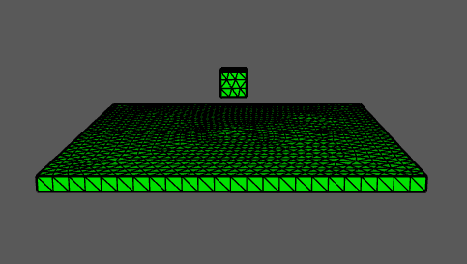
Example: Rotating and Translating magnet
Cross-validation of $A‐φ$ and $T‐Ω$ method
Analysis: 2seconds, 181steps
Unknown equivalent
(Identical mesh)
Radia
Kelvin Sphere
Items | Parameter | Value
PM | Remanence | 0.2 T
 | Dimensions | 1×1×1 mm³
Copper plate | Dimensions | 12×12×0.5 mm³
 | Conductivity σ | 5.8×10⁷ S/m
PM motion | Translation | X: -6→4 mm
 | Rotation | 720° about Z-axis
NGSolve
Target model
Example of natural language prompt:
Pre-registered skills: Run Kelvin transformation
9
Notes:
For the Kelvin transformation, the user only adds one sentence to the prompt: Pre-registered skills, run Kelvin transformation. The MCP server then automatically incorporates the Kelvin transformation into the generated code. The roles in the generated code are as follows. Radia, or IEM and MMMM, computes the external field of the moving magnet. Translation and rotation are handled only by coordinate updates. NGSolve, or FEM, computes the eddy currents and reaction field in the copper plate using the reduced potential method. The Kelvin sphere connects the inner target model and the outer Kelvin-transformed region with an identical mesh, so open-boundary conditions are handled accurately. In other words, the generated code contains the Radia, NGSolve, and Kelvin-sphere roles at the same time.

Slide 13
Example: Rotating and Translating magnet
Cross-validation of $A‐φ$ and $T‐Ω$ method
Analysis: 2seconds, 181steps
Items | Parameter | Value
PM | Remanence | 0.2 T
 | Dimensions | 1×1×1 mm³
Copper plate | Dimensions | 12×12×0.5 mm³
 | Conductivity σ | 5.8×10⁷ S/m
PM motion | Translation | X: -6→4 mm
 | Rotation | 720° about Z-axis
Target model
9
Notes:
Under this configuration, let us look at the behavior of the full target model as the magnet moves. The visualization shows how the external magnetic field generated by the magnet changes as the magnet translates along the X direction and rotates about the Z axis. Please note that this visualization shows only the external field from the magnet. It does not show the eddy-current distribution or the reaction field. The entire analysis code, including Kelvin transformation, reduced potential formulation, and both A-phi and T-Omega paths, is generated automatically from a natural language prompt. Now let us look at quantitative results.

Slide 14
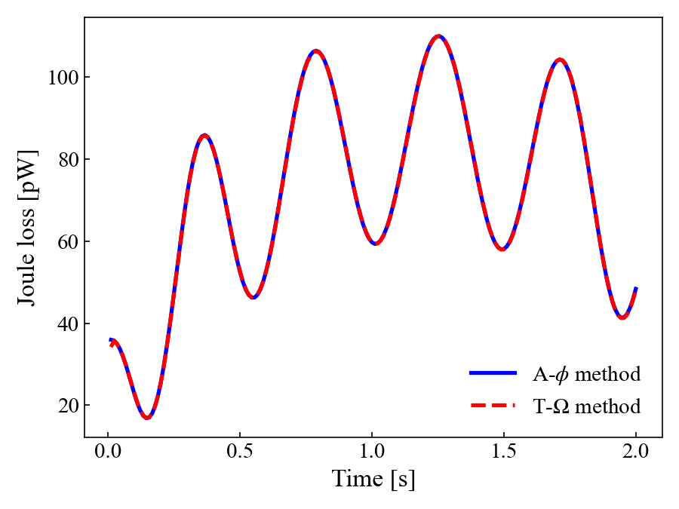
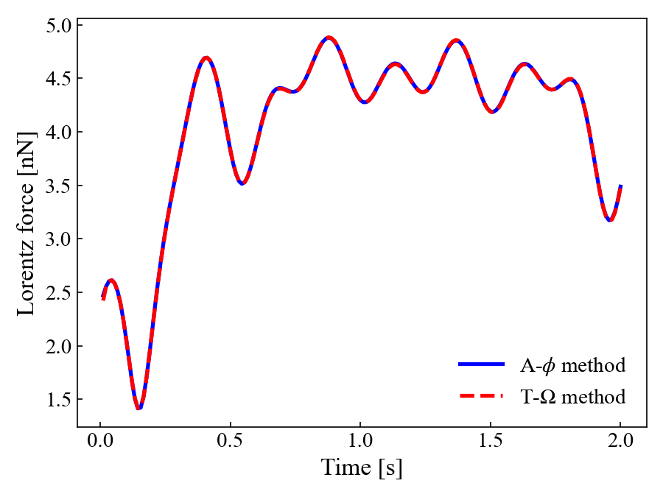
Example: Result of Rotating and Translating magnet
Element Order : p＝2
Joule loss vs. Time
Lorentz force vs. Time
• Consistent results across different formulations
→Validates implementation
• Analysis without remeshing
→ High applicability to moving object problems
Physical values | MRE
Joule loss P | 0.21%
Lorentz force |F| | 0.11%
10
Notes:
This slide shows the result with element order p equals 2. Over all 181 time steps, the A-phi and T-Omega paths agree within 0.21 percent for Joule loss and 0.11 percent for Lorentz force. These two paths are generated independently, and the unknowns and finite element spaces are different. The A-phi formulation is centered on the magnetic vector potential A, while the T-Omega formulation is centered on the electric vector potential T. When needed, magnetic flux density B is projected into an H-Div space. The high agreement between the two paths gives quantitative evidence that the generated code is physically consistent. What I want to show here is that, with p equals 2, two independently generated formulations return the same physical quantities even under a moving external field.

Slide 15
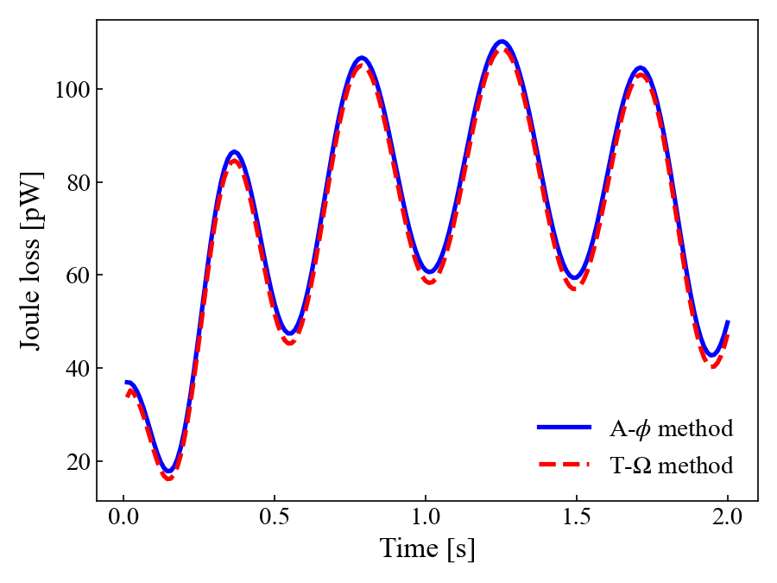
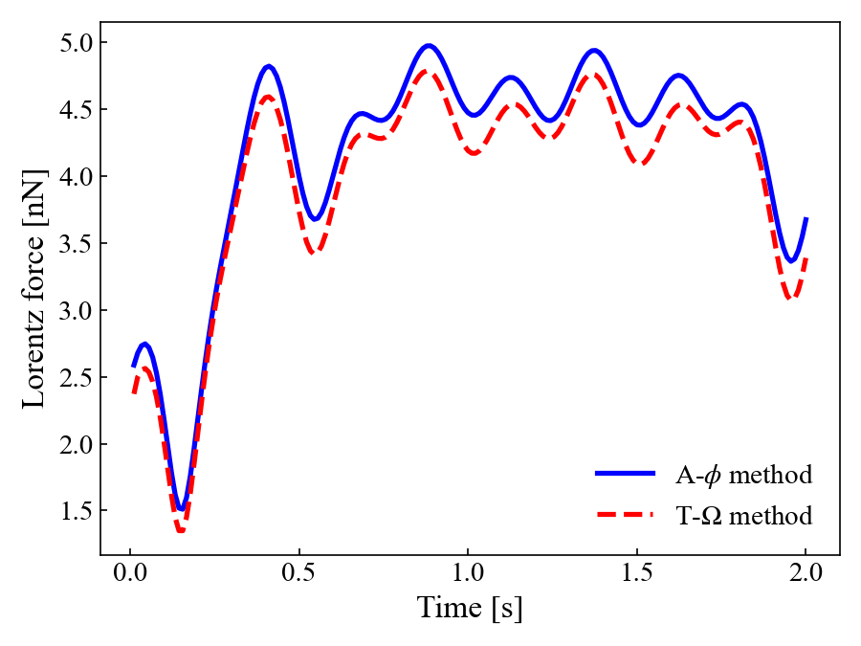
Example: Result of Rotating and Translating magnet
Element Order : p＝1
Joule loss vs. Time
Lorentz force vs. Time
• Consistent results across different formulations
→Validates implementation
• Analysis without remeshing
→ High applicability to moving object problems
Physical values | MRE
Joule loss P | 3.41%
Lorentz force |F| | 5.19%
10
Notes:
To clarify the meaning of the previous result, this slide shows the result with p equals 1. The mean relative error increases to 3.41 percent for Joule loss and 5.19 percent for Lorentz force. The two formulations still converge to the same physical solution, so the implementation is consistent. However, for engineering use, this accuracy is not sufficient. The comparison shows that changing from p equals 1 to p equals 2 is not just a parameter change. It is the accuracy improvement provided by NGSolve's high-order formulation. The same generated code reveals this difference simply by changing the element order. For NGSolve users, this may sound natural, but the message here is that high-order elements still work properly inside the Radia-NGSolve coupling framework.

Slide 16
Summary
MMMM × NGSolve Coupling
Moving body handled by Radia (MMMM) → NGSolve mesh stays completely fixed
MCP Server for Radia-NGSolve
Natural language prompt → complete, Lint-checked implementation code
This framework is publicly available on GitHub.
(https://github.com/ksugahar/Radia)
11
Notes:
Let me summarize the talk. First, MMMM and NGSolve coupling. The moving magnet domain is handled by MMMM in Radia, and the conductor domain with eddy currents is handled by NGSolve. This keeps the NGSolve mesh fixed, with no remeshing and no mapping error. The external field from Radia is passed directly to NGSolve as a CoefficientFunction, so NGSolve can use high-order elements on a fixed mesh without losing accuracy because of motion. Second, the MCP server for Radia-NGSolve. The reduced potential formulations and Kelvin transformation are stored as knowledge and skills. From a natural language prompt, the user can obtain implementation code checked by lint. This framework is publicly available on GitHub.

Slide 17
Thank you for listening
Notes:
That concludes my presentation. Thank you very much for listening.

